Slide 1
WHAT COULD THIS BE?
The square of dark soil shows where a ditch was once dug.
The dark soil in the middle shows where a large hole was dug. What could have been in the hole?
Notes:
East Riding Museum

Slide 2
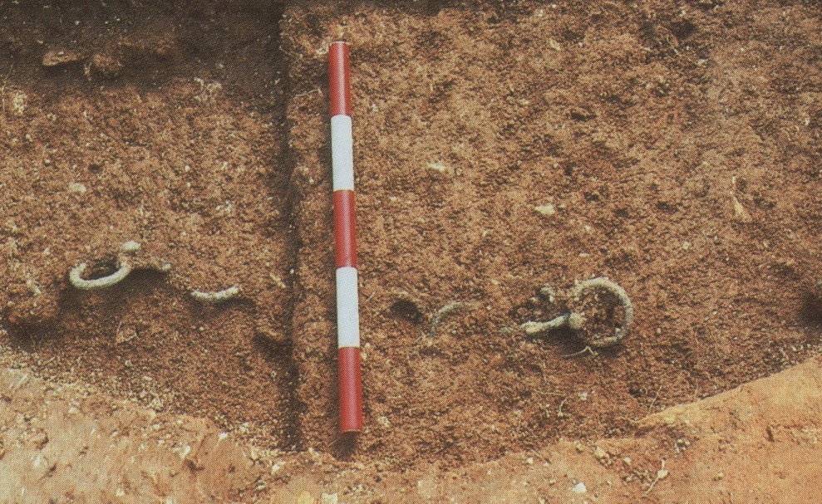
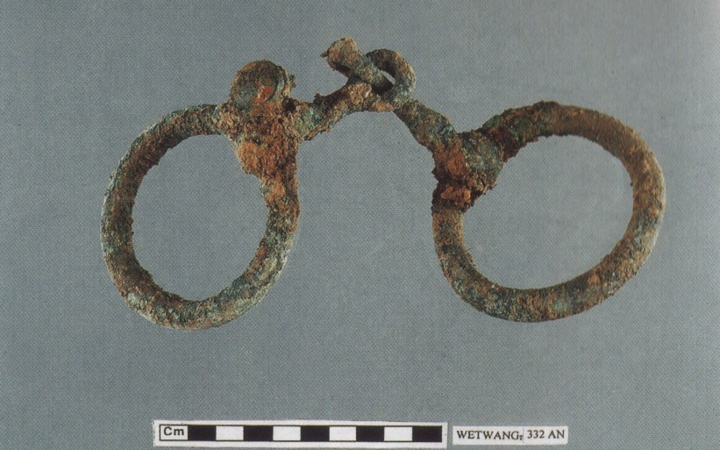
Digging into the pit: Stage 1
You have uncovered two sets of double rings. What do you think they were for?
This is one of the two.
Notes:
East Riding Museum

Slide 3
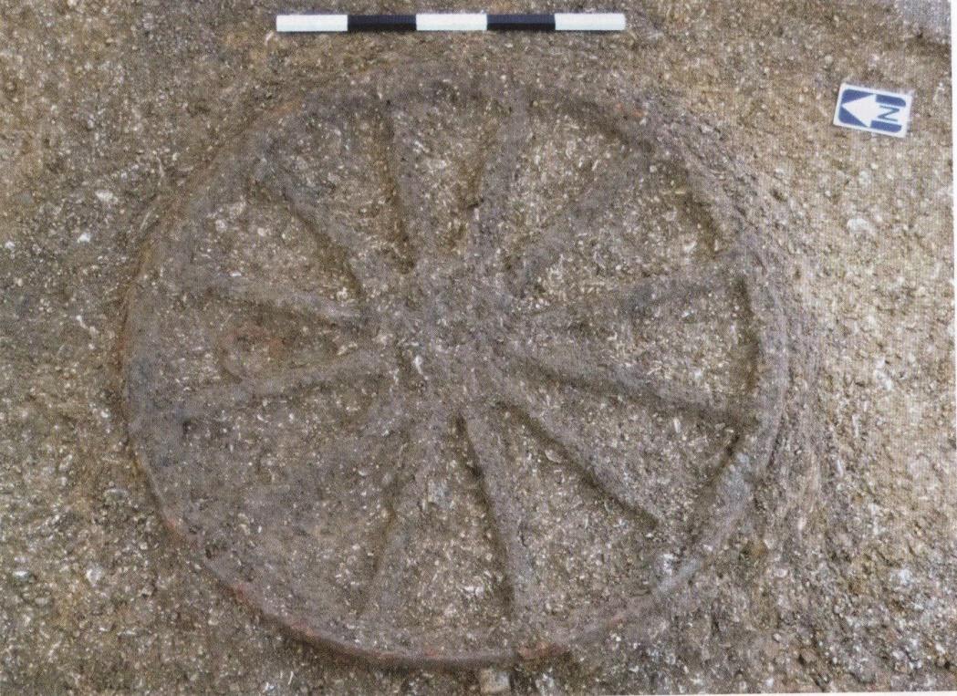
Digging into the pit: Stage 2
Now these marks in the soil have appeared.
They show where wood has rotted away. There are two of them.
What do you think they once were?

Slide 4
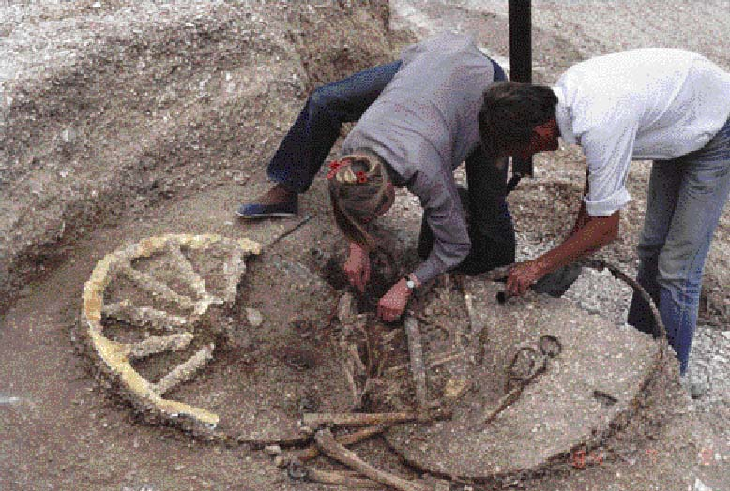
Digging into the pit: Stage 3
What can you see now? What do you think it is?
Notes:
Courtesy Trustees of the British Museum

Slide 5
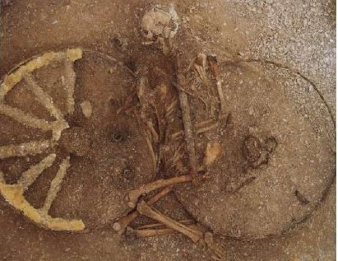
Digging in to the pit: Stage 4
Can you see the sword laid on top of the skeleton?
What does that tell us about the man who has been buried here?
Can you see the iron hoops of the wheels?
The burial has been laid on something that has had its wheels taken off. What do you think it was?
Notes:
Courtesy Trustees of the British Museum

Slide 6
For the first time we can turn to something that was written down to help us decide. A Roman general called Julius Caesar had invaded Britain in 55BC and this what he said:
“At the start of a battle the Britons charge around in their chariots throwing spears. Then they jump down and fight. By daily training they become so good that they can run along the chariot pole and stand on the yoke between the horses’ necks.”

Slide 7
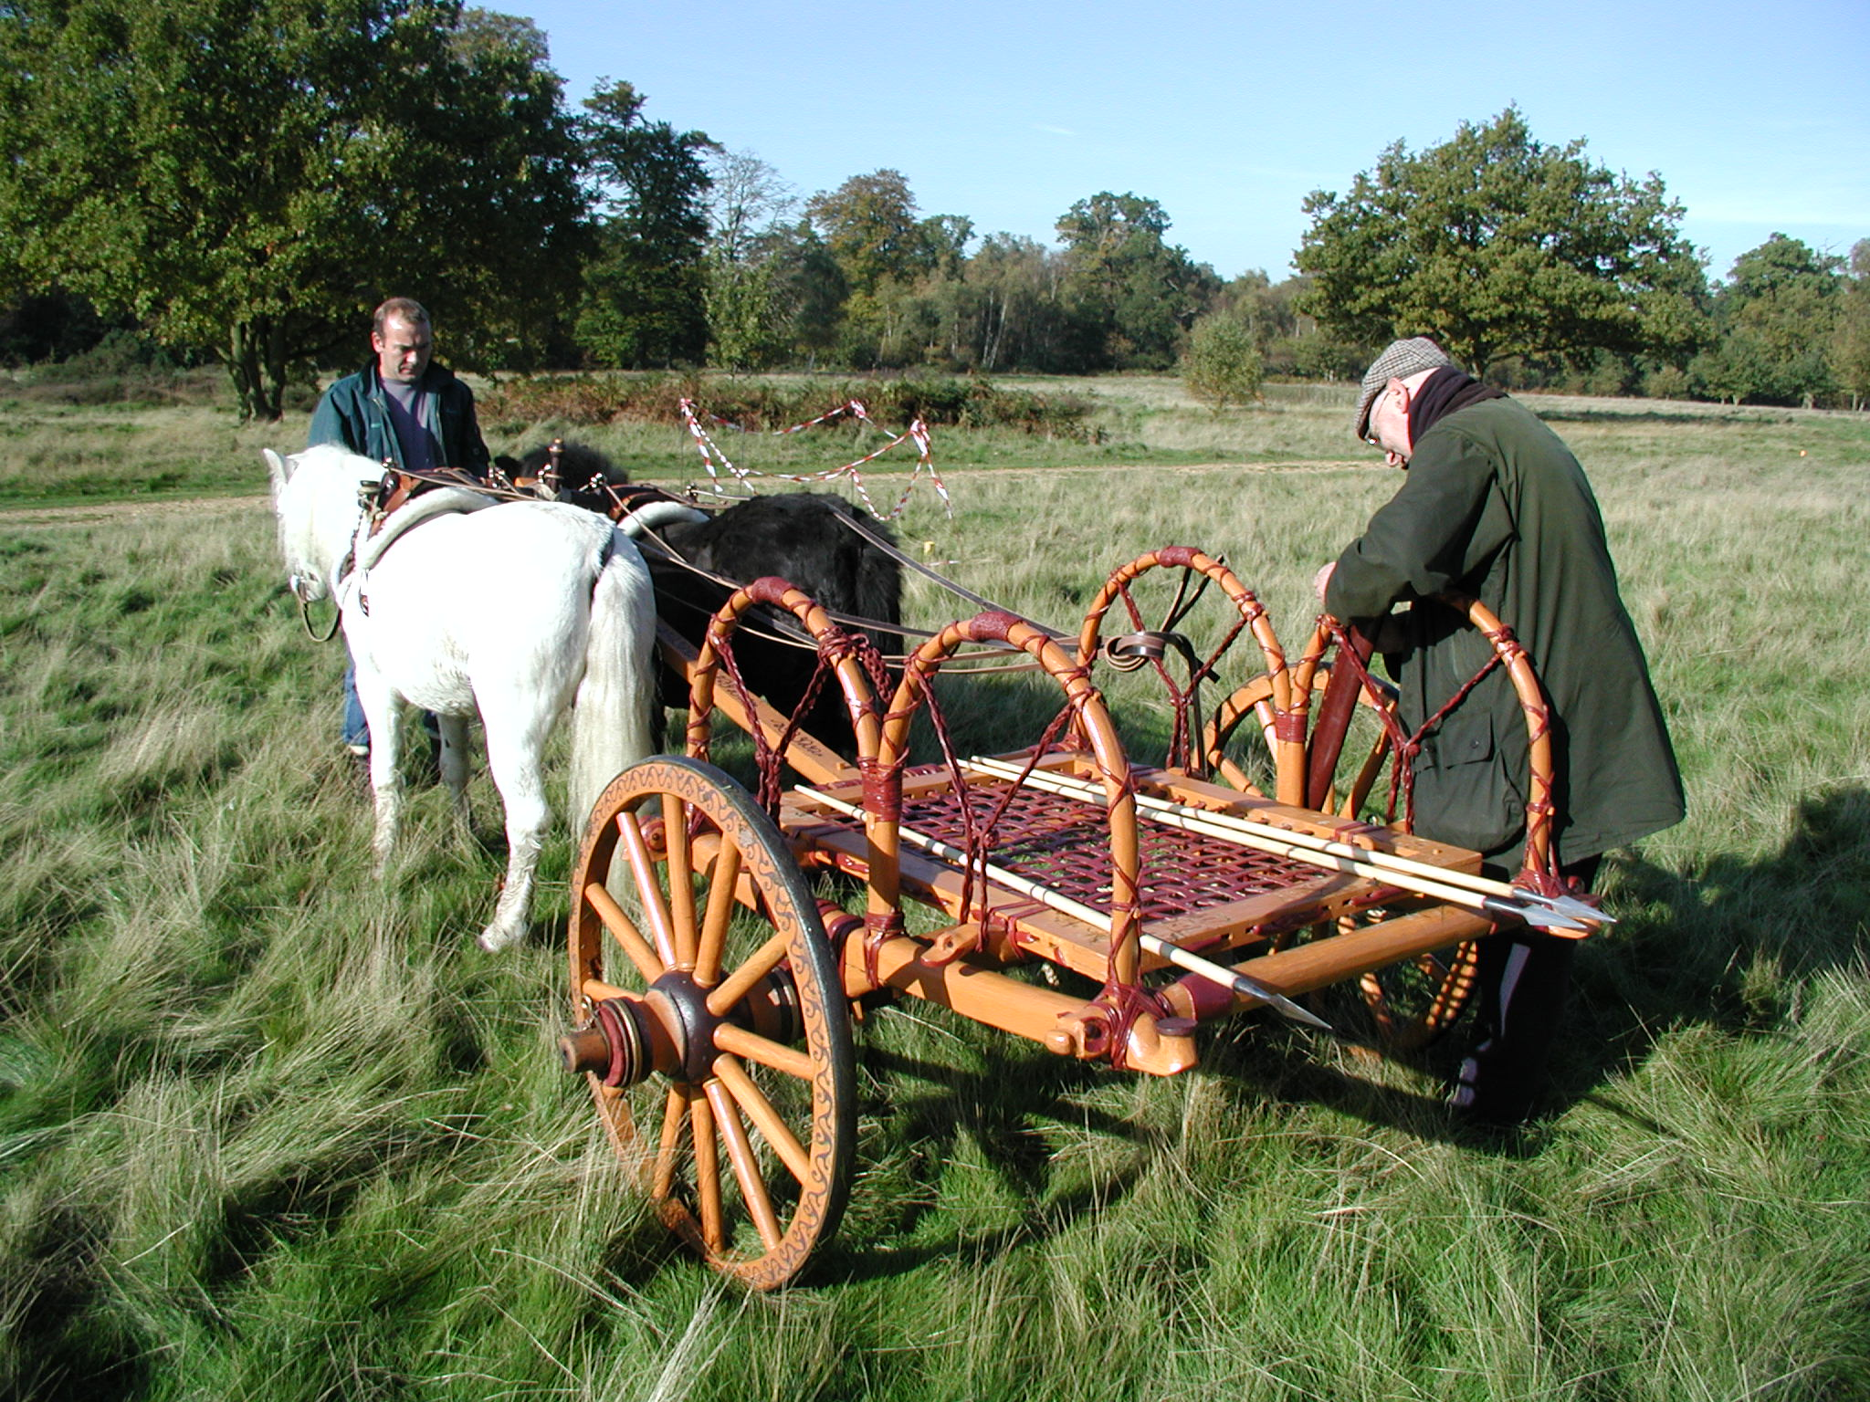
So we can reconstruct the cart as a chariot
that was buried with a warrior.
Notes:
Courtesy Trustees of the British museum

Slide 8
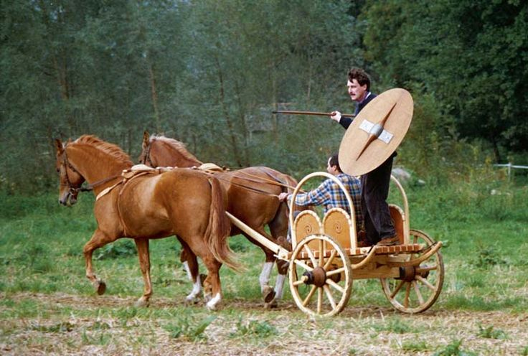
Here is another reconstructed chariot actually being used. It has been made with an open front because of something Julius Caesar said. What was that?
Notes:
Courtesy Trustees of the British Museum

Slide 9
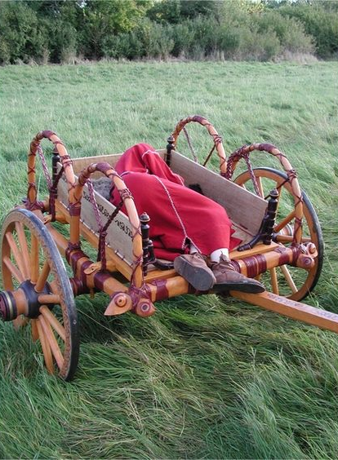
It wasn’t only men who were buried in chariots.
This is the reconstruction of the burial of a woman in a fine chariot. It had glistening bronze rings for the reins. They were decorated with coral. She was buried with a bronze mirror and a brooch. She must have been very important.
Was she also a warrior or was this just her fine carriage?
Notes:
Courtesy Trustees of the British Museum

Slide 10
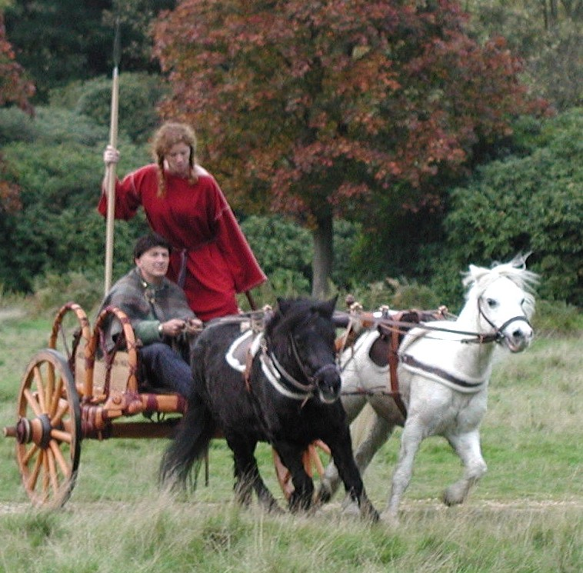
We know of one queen who led her army into battle on a chariot. She was called Boudicca.
We know her name and what happened because the Romans wrote it down. They had invaded Britain in 43AD and taken over. They treated her family and her tribe very badly so she called her warriors together to drive the Romans out.
Courtesy British Museum
Warriors came from other tribes as well. Soon she had an army of thousands. She led them in her chariot to the towns that the Romans had built at Colchester, London and St Albans. Her army burned them down. But the Roman army that had been fighting far away in Wales was marching back…

Slide 11
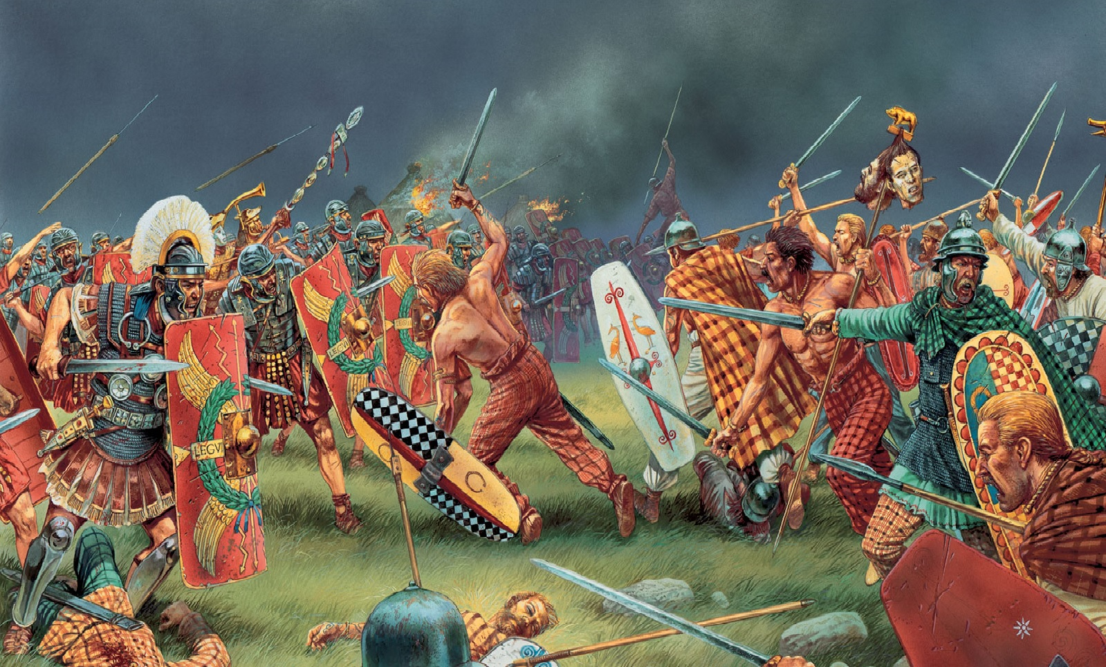
…The Romans were outnumbered 10 to 1 but they found a narrow valley with dense woods around it so they couldn’t be attacked from the sides. Then they made a wall with their shields across the valley. Boudicca’s warriors charged all day but couldn’t break through. They were exhausted. Then the Romans attacked. Her army was defeated and fled. Boudicca took poison to avoid being made a prisoner.
Notes:
©warlordgames

Slide 12
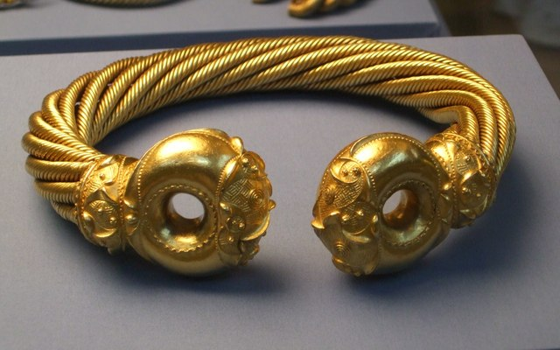
This is a torc. It is a great gold ring that was worn around the neck. It was found with lots of others in Boudicca’s kingdom. Perhaps it belonged to her. Nobody knows where she was buried.
Notes:
© Courtesy Trustees of the British Museum

Slide 13
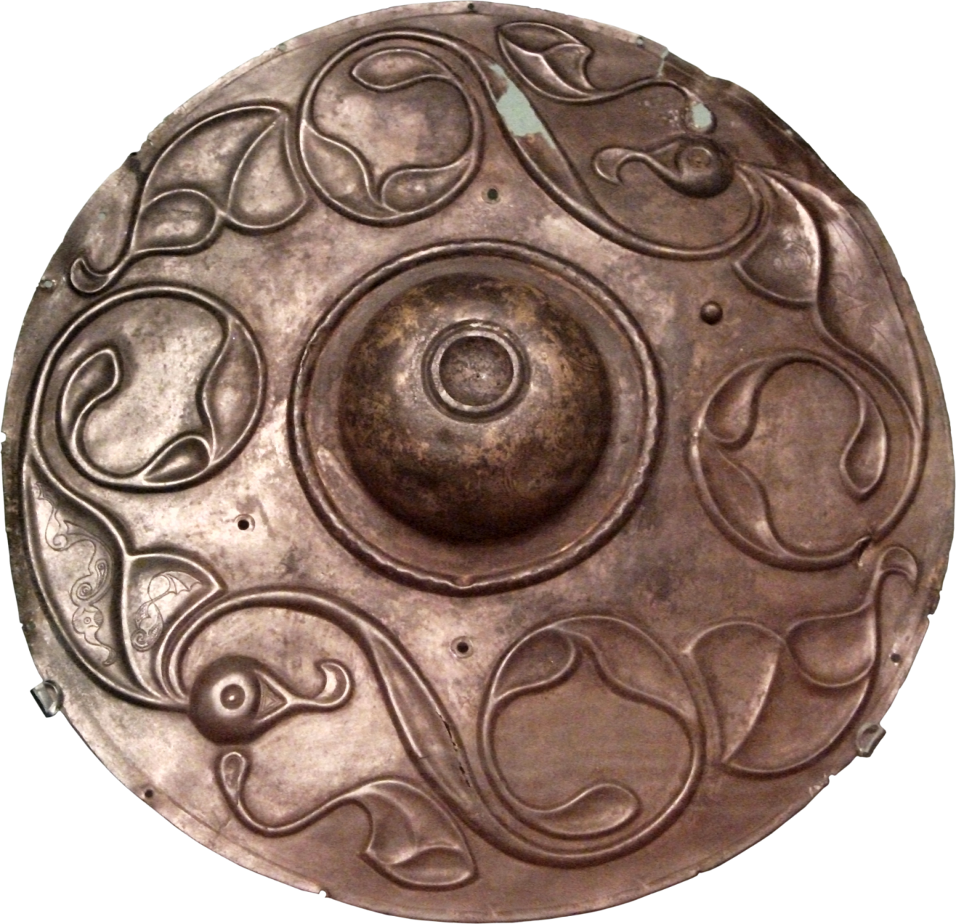
The central metal boss (hand protector) of a wooden shield that has completely rotted away.
Notes:
© Courtesy Trustees of the British Museum

Slide 14
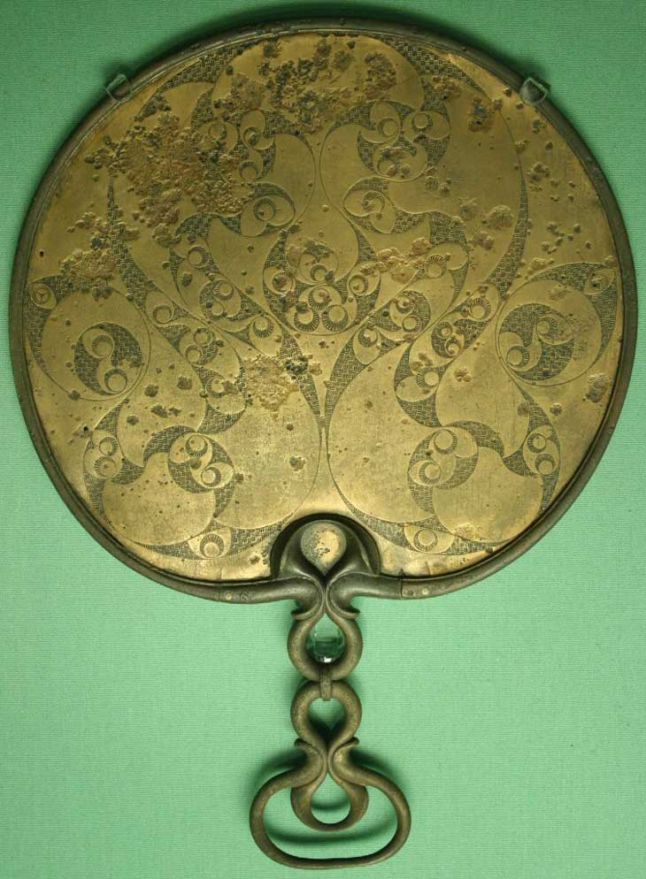
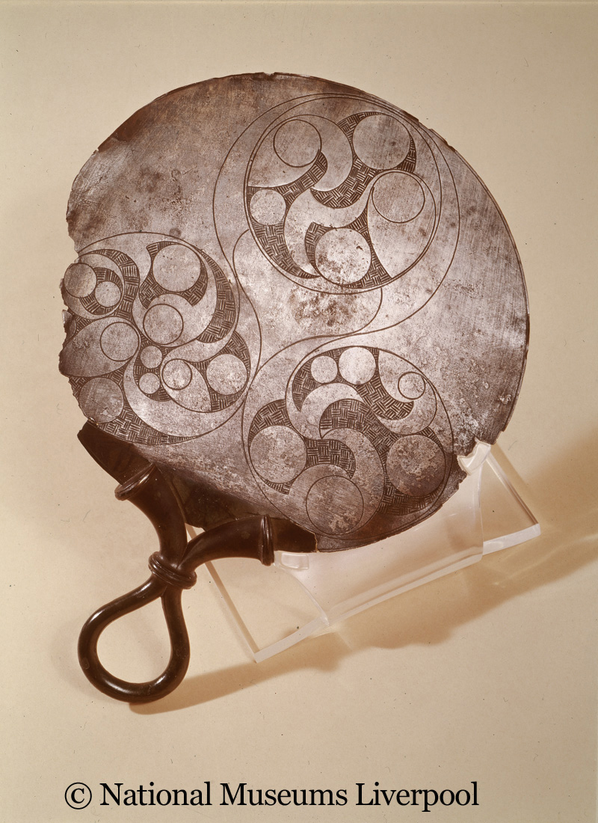
Bronze mirrors
Notes:
Right: © Courtesy Trustees of the British Museum. Left, copyright National Museums Liverpool.

