Slide 1
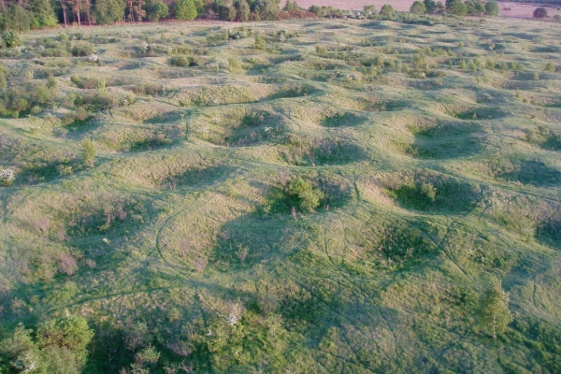
GRIMES GRAVES
What do you think all these hollows in the ground are?

Slide 2
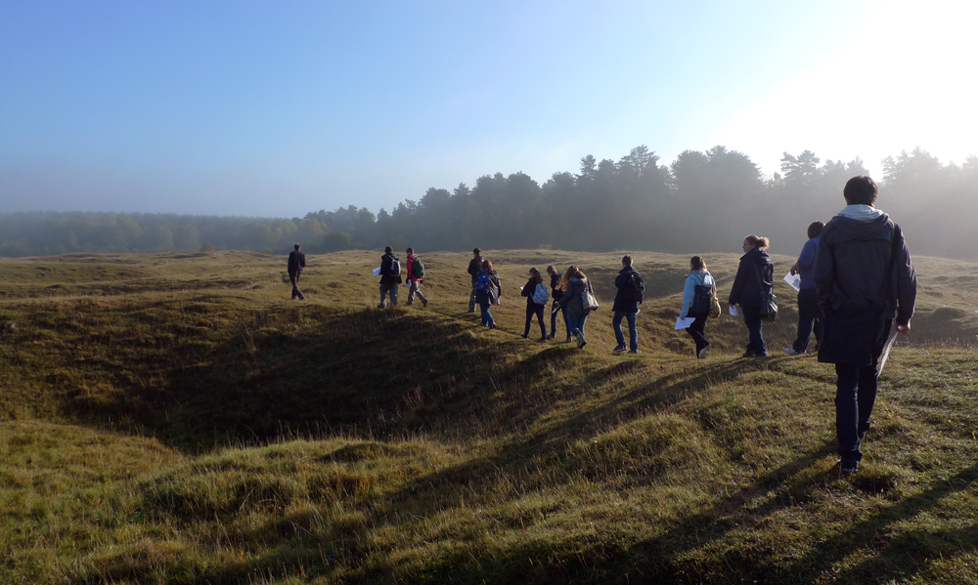
They are quite deep today but once they were much deeper.
Let’s excavate one and find out what they were for.
Notes:
Copyright University of East Anglia

Slide 3
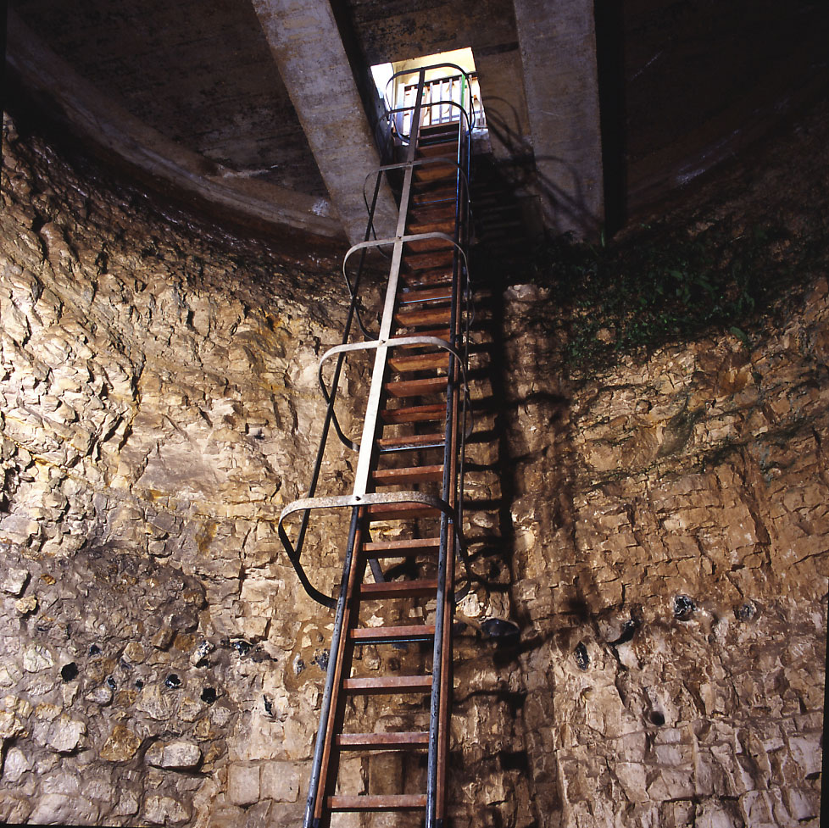
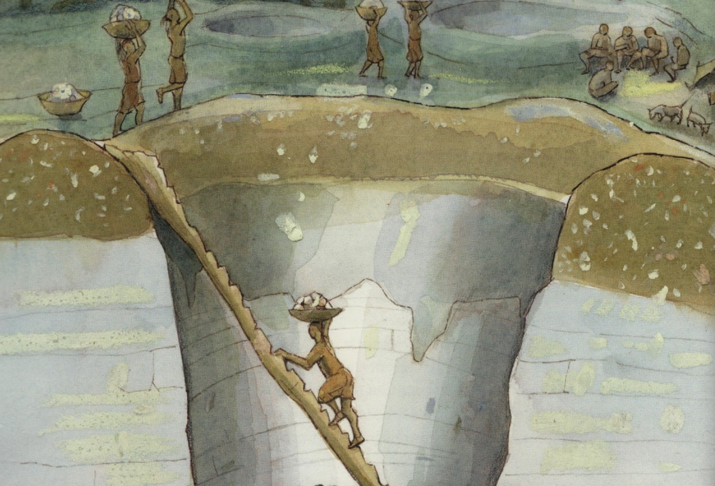
Excavating the first 5 metres down
Why do you think people dug this pit?
The pit today
The pit then
Notes:
© Historic England

Slide 4
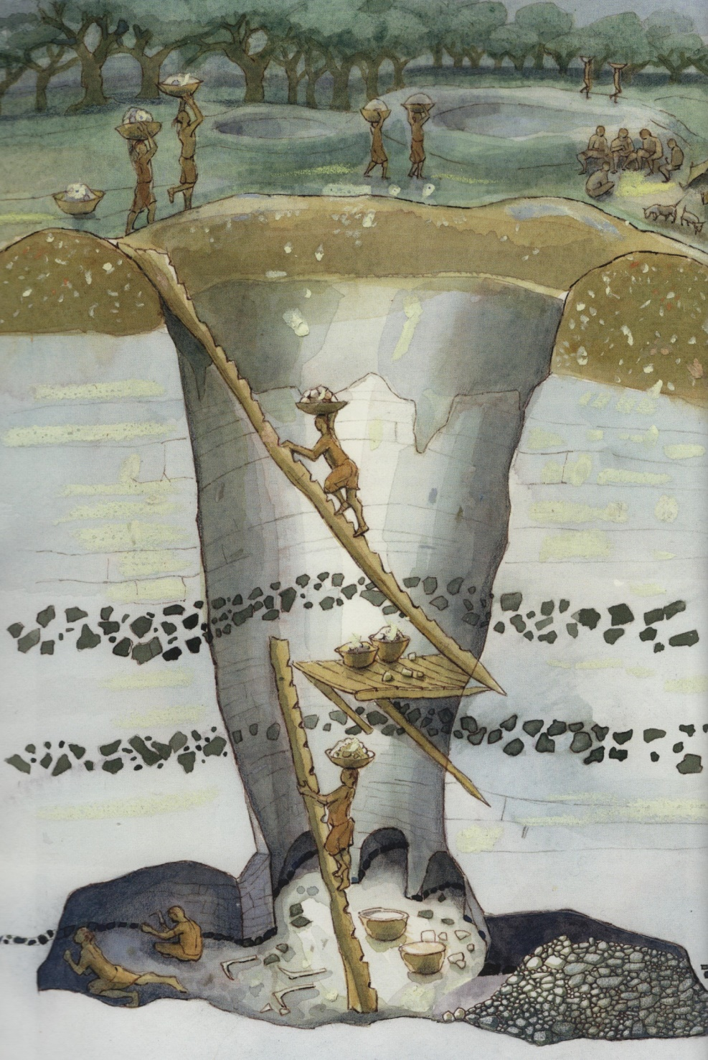
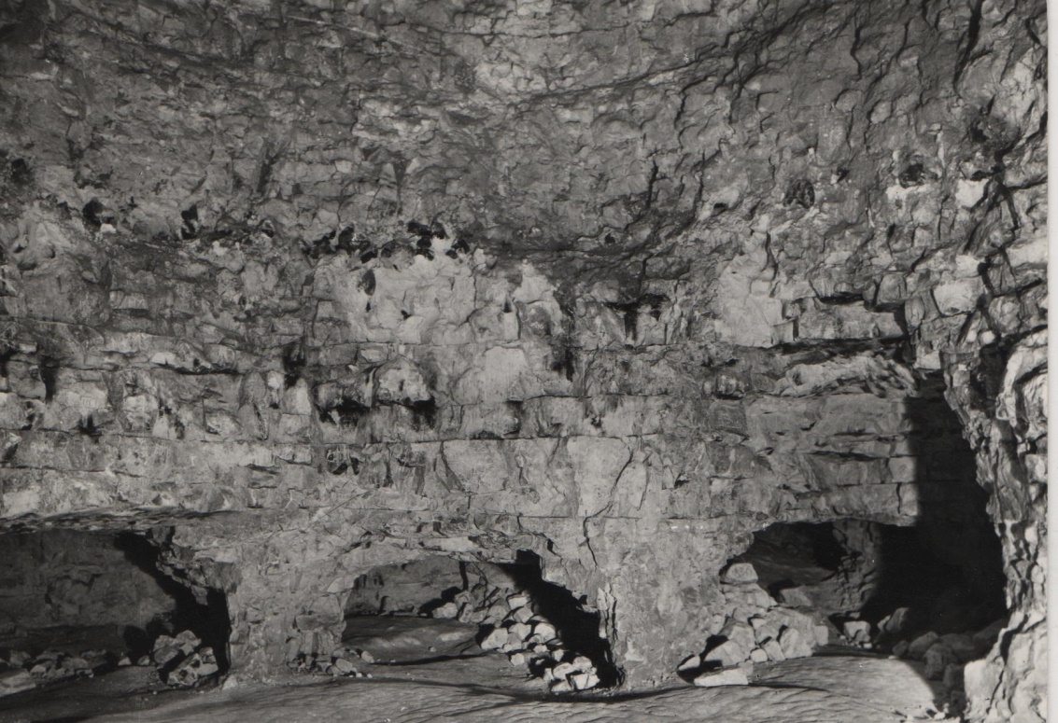
Excavating to the bottom of the pit: 10 metres down
There are tunnels at the bottom of the pit. What do you think they were dug for? It was something they really needed.
The pit today
The pit then
Notes:
© Historic England

Slide 5
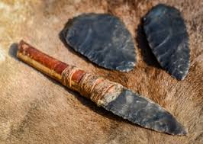
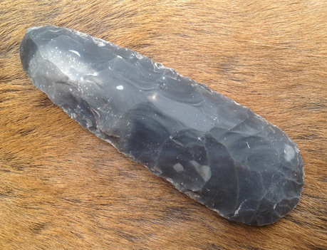
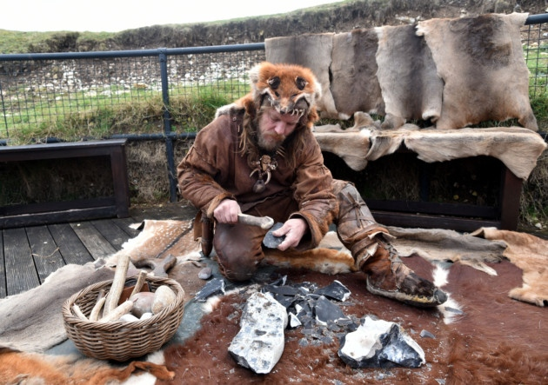
Flint
The best flint was 10 metres down, so they had to mine for it. It was used to make axes and other tools.
How old are the mines? Use the Archaeologist’s Fact File to find out by looking for tools like these.
Notes:
Courtesy: John Lord

Slide 6
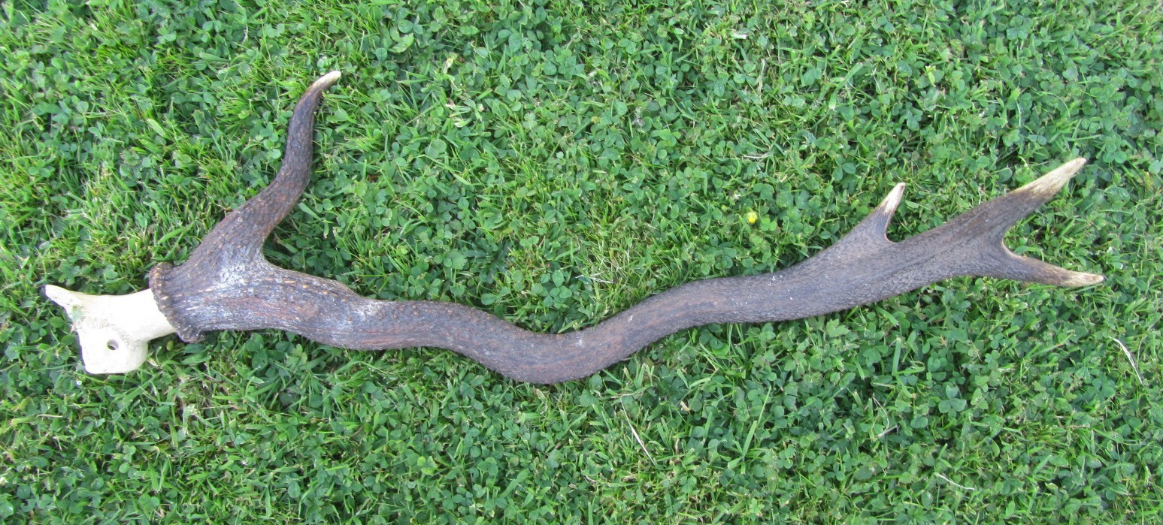
Lots of these were found in and around the mines.
What are they?
Why do you think they were there?

Slide 7
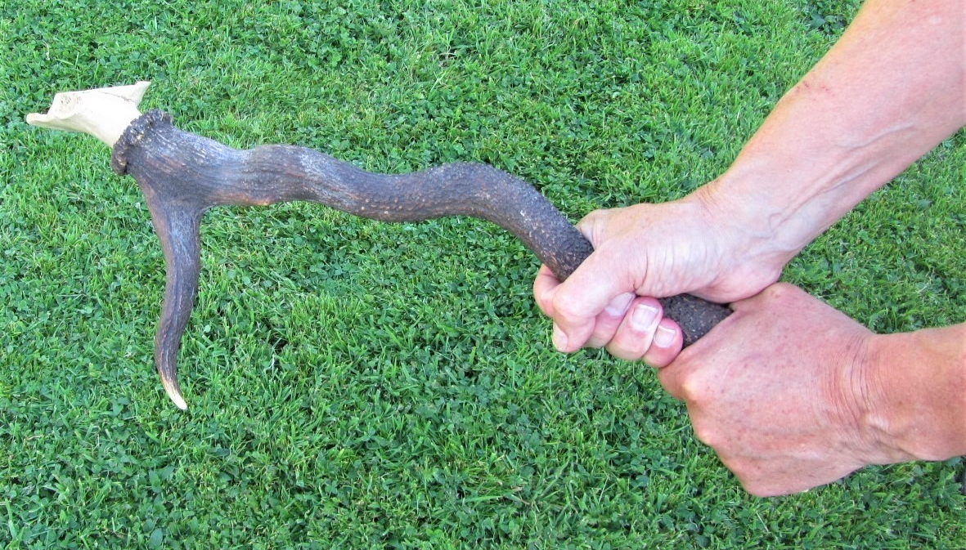
They are red deer antlers.
They were used as picks by the miners to dig the tunnels
and lever out the blocks of flint.

Slide 8
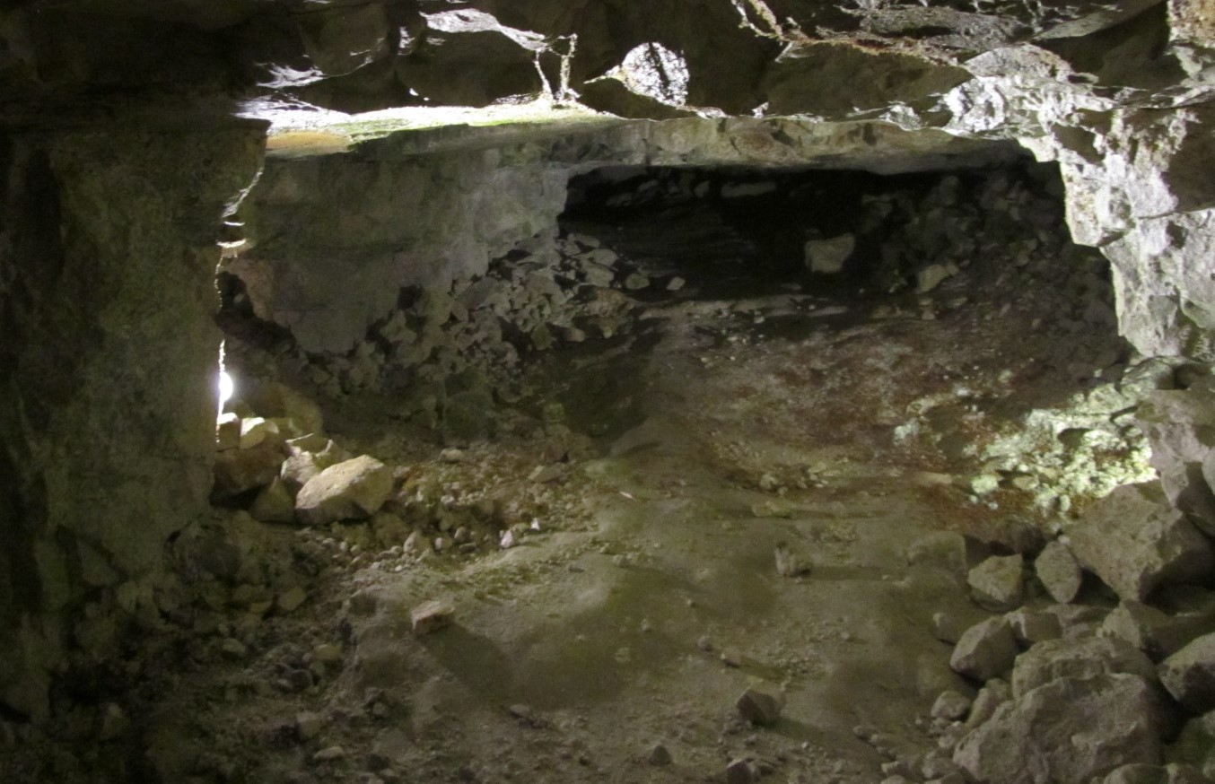
The tunnels that they dug were very low.
The miners had to bend or crawl as they worked.
Imagine working in this tunnel.

